Slide 2
Agenda:
Introductions by Dr Parsons and Dr Wade (making it work in your practice)
The Clinically Organized Relevant Exam (CORE) Back Tool walkthrough, Pattern Recognition and Management
Small Group Activity (Case Studies)
Dr. Hogan: Assessment Management and Treatment, Criteria for Surgical Consult
Referral Options for Conservative Management, New programs, Algorithm, Community Resources
Evaluation and Closing Remarks

Slide 3
Managing Low Back Pain in Primary Health Care
June 15, 2023

Slide 4
Presenters and Organizers
NLHS Physiotherapists
Tracy Penney
Dianne Penney
Laura Bryant
Nicole Peters
Emily Dawe
Hosting Physicians
Dr. Ean Parsons
Dr. Jessica Wade
Dr. T. Guy Hogan
Endeavor Family Practice Network
Adam Wylie
Matt Carroll

Slide 5
Low Back Pain - Causes
Only 1-4% of people with LBP have serious spinal conditions.
Mechanical LBP comprises 85-90% of ALL back pain.
Imaging of the spine provides poor correlation to patients symptoms (Brinjikji et al 2015)
Henschke et al (2009), Rampersaud et al (2013), Hall & Boyle (2009), Finucane et al (2020)
Notes:
Recognize the impact on Health Care system. From work time loss, to management of LBP within primary care, to limited resources and long wait time for conservative management.
No identifiable pathoanatomical source to explain their pain in 80 % of LBP. 5-8% radiculopathy ; 9-11% neurogenic claudication; “syndromes
What is Mechanical LBP? Structures in the spine produce pain when it is loaded or moved, and pain is reduced with certain movements or positions.
Metastasis 1%
Spinal infection 1%
Compression fracture 1-4%
Cauda Equina 0.5%
Recognize the impact on Health Care system. From work time loss, to management of LBP within primary care, to limited resources and long wait time for conservative management.
Brinjiki et all did CT’s and MRI’s on Asymptomatic people- CT and MRI DDD: 37% in 20 yo, 96 % of 80 yo; Disc bulge 30% in 20 yo, 84% of 80 yo.
Treatment guided by clinical findings not diagnostic imaging findings. DI only relevant when correlates to symptoms

Slide 6
A Different Approach
Appropriate and timely education at the first incidence of LBP has been shown to contribute to the prevention of chronic LBP.
“Distinct patterns of reliable clinical findings are the only logical basis of back pain categorization and subsequent treatment” - Quebec Task Force 1987
Benefits to LBP Classification Systems
Rampersaud et al (2013); Mosely & Butler (2015), Hurley et al (2016), Traeger et al (2015), Richardson et al (2015)
Notes:
Completing a thorough history and physical exam is essential to help guide diagnosis/ syndrome.
Specific pathway to help classify LBP into categories, guides your treatment approach.
Efficient, appropriate, timely, reduce pain and disability, reduced chronicity, helps determine appropriateness for imaging and referrals to specialists or surgeons.

Slide 7
CORE Pathway
Notes:
This evidence based care pathway was developed in Ontario and is widely available to PHC providers. Alberta and Saskatchewan have similar pathways/ documents.Section a section B ets….

Slide 8
Section A: Subjective History
Notes:
These questions, when done properly will help you to narrow down the grouping of the patient’s LBP.
These 6 questions have high value help classify LBP pathway. Develops working diagnosis and guides physical exam to confirm or changes diagnosis.
Subjective history takes precedence over physical exam.

Slide 9
Question 1 Back vs Leg Dominant
Back pain- low back, buttocks, gluteal fold, groin or lateral aspect of hips
Leg pain- below the gluteal fold, to the thigh, calf or foot
“Where is your pain the worst?”
“If I could take away one pain, what would it be?”
Notes:
All leg pain is not sciatica
Referred pain is typically intermittent, back dominant and in a non-dermatomal pattern. Radicular pain is typically leg dominant and can be constant or intermittent and in a dermatomal pattern.
Radicular pain- 60% will resolve in 4-6 weeks and can take up to a year to completely resolve.
If pain is back dominant Pattern 1 or 2
If pain is leg dominant Pattern 3 or 4

Slide 10
Question 2 Constant vs Intermittent
“Is there ever a moment when your pain stops for a brief moment, even if it comes right back?”
“When your pain is gone, is it completely gone?”
**Back dominant, intermittent pain is always mechanical!
Notes:
True intermittent pain is never a malignancy
Patients confuse constant pain with daily or frequent pain.
To be truly intermittent, the pain will be gone completely (0/10) for at least a few seconds.
Can see after question 2 you should have pattern figured out, except intermittent back dominant could be Pattern 1 or 2
Indicates ruling out red flags for constant but should always be ruled out.

Slide 11
Question 3 Aggravating & Relieving Positions/ Movements
“Is there any position or movement that increases your pain?”
“Is there any position or movement that decreases your pain?”
Notes:
You may need to ask each specific activity or position that may be aggravating or relieving.
Flexion: Does your pain feel worse or better with sitting and bending forward?
Extension: Does you pain feel worse or better with standing and walking?
Other: Lying down
If yes- MEHCANICAL
Determines which direction of movement/positions may help their symptoms
In absence of red
Back dominant constant flexion and/or extension Pattern 1
Back dominant intermittent extension Pattern 2
Leg dominant constant flexion and extension Pattern 3
Leg dominant intermittent extension Pattern 4

Slide 12
Question 4 Yellow Flag Screen
“Is there anything you can NOT do now that you could do before the onset of your low back pain?”
Notes:
Keele Start Back
This is not on your first meeting, but after 6 weeks of APPROPRIATE conservative management.
Answering yes to any of these questions, you provide education about that topic. E.g. if believe that activity is harmful, provide education re: hurt vs harm and how activity has been shown to improve and prevent LBP.

Slide 13
Question 5 Red Flag Screen
“Have you had any unexpected accidents or changes with your bowel or bladder function since this episode of your low back pain started?”
Notes:
Red Flag questions are mandatory in any back exam.
You often know your patients’ medical history of cancer, steroid use, drug use, recent infection or they tell you back pain started after a fall.
Neurologic
Infection: recent surgery, IV drug use, fever, HIV, weight loss
Fracture: recent trauma, female, age > 50, steroid or IV drug history
Tumour: Hx of Cancer, night pain, weight loss, severe fatigue
Inflammation: age <45, > 3 months of LBP, morning pain/ stiffness >30 min

Slide 14
Question 6 Systemic Inflammatory Arthritis Screen
If age of onset <45 years and > 3 months of LBP:
“Are you experiencing morning stiffness in your back >30 minutes?”
Notes:
If noted on initial assessment, this may be part of follow up visit after a period of conservative management to see if this will improve.

Slide 15
Other Questions
“Have you had this same pain before?”
“Have you had treatment before?”
Notes:
These questions are not in the CORE Back Tool but they are in the Saskatchewan Spine Pathway and RAC pathway.
If previous episode and responded to certain conservative measures, helps with reassurance and education, referrals to other clinicians, etc.

Slide 16
Section B Physical Exam
Motor Tests
L4- Ankle DF, Patellar Reflex
L5- Great Toe Extension, Hip Abduction
S1- Great Toe Flexion, Glut Max, Achilles Reflex
Nerve Root Irritation Test
UMNL Test
Saddle Sensation
Notes:
The clinical exam purpose is to confirm your history. History takes precedence.
The majority of nerve root issues are L5-S1 (80%) L5 hip abductors, S1 glute max. L4 (8%)
You to do neurological motor test for each nerve root….key muscle or DTR
You need to do a nerve irritative test-SLR
You need to do a upper motor neuron test-Babinski
You need to do saddle sensation test
If specific nerve root suspected do 2 nerve conduction tests (ex L5 do great toe and hip abduction) to confirm or rule out.
If back dominant do full test, but one for each.
Look at rhythm of movement (flex and ext): reproduction of typical pain. Hands low on buttock during extension.
For L4 we perform patellar reflex – Jendrassik manouever
Plantar response: down going negative (toes curl down). Abnormal toes flare up.
SLR is passive test, flex opposite hip and knee. Positive is reproduction of pts typical leg symptoms at ANY degree of elevation.
Midline sensation of upper buttock

Slide 17
Section C: Initial Management
Notes:
Most will be Pattern 1 & pattern 4

Slide 18
Pattern 1
Back Dominant
Constant or Intermittent
Worse with flexion/sitting (+/- extension)
Fast responder: only worse with flexion, better with unloaded extension
Slow responder: worse with flexion and extension, worse with unloaded extension. Tough to treat!
Neuro Exam negative
Treatment
Education & reassurance
Fast responder: Positions – Z lie, lumbar roll, Sloppy pushups
Slow responder: Positions – Z lie, knee to chest, prone over pillow. Progress to sloppy pushups
Notes:
Back pain includes: low back, buttock to gluteal fold, greater trochanter and groin.
Recheck with patient in 2-4 weeks

Slide 19
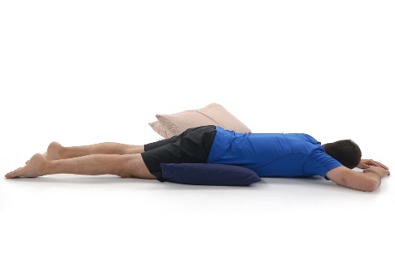
Positions of Ease
Z Lie
Prone Over Pillows

Slide 20
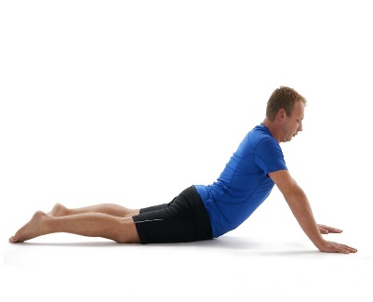
Positions of Ease
Knees to Chest
Sloppy Push Up

Slide 21
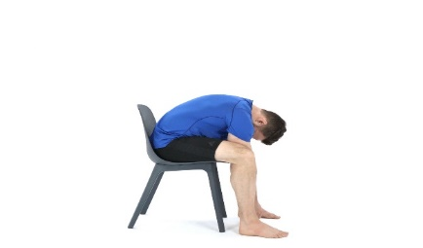
Pattern 2
Back Dominant
Always intermittent
Worse with extension
Never worse with flexion
Neuro Exam negative
Treatment:
Education & reassurance
Positions: Z lie, knee to chest, correct sitting and standing postures
Exercises: knee to chest, sitting flexion
Notes:
Only 3% , generally easier to treat.
Responds quickly to correct positioning, exercise, etc.
Recheck in 2-4 weeks

Slide 22
Pattern 3
Leg Dominant
Constant
Neuro Exam: Positive nerve root irritative test (SLR) and may also have conduction loss in neuro exam
Treatment:
Education & reassurance
NO exercises
Positions of comfort 20-40 min/hour – Z lie, prone on pillows, hands and knees, lumbar supports
Notes:
No such thing as intermittent sciatica. It is a chemical response. It may get better and worse but does not disappear.
Centralization and peripheralization. Once centralized switch to pattern one.
Activity as tolerated, not complete rest
May take four months for pain to begin to resolve, with proper treatment.
When becomes intermittent and back pain dominant may change to pattern 1.
Recheck with patient in 2 weeks.

Slide 23
Pattern 4
Leg Dominant
Always intermittent
Worse with extension activities, i.e. walking
Better with rest and flexion
Neuro Exam: Negative irritative tests and possible conduction loss
Treatment:
Education & reassurance
Positions – flexion, Z- lie, pelvic tilt, sitting postures, forward flexion
Exercises: flexion stretches, core strength and long term management
Notes:
Neurogenic Claudication vs vascular
Response to rest
Build strength is long term
Recheck with patient in 6-12 weeks

Slide 24
Non-mechanical
If pattern of pain is not identified, patient has non-mechanical pain
These patients may have a pain disorder
Beyond the scope of this lecture
Notes:
3/5 100% accuracy
3/5 80%
Will not fit into pattern, have yellow flags, likely pain disorder This is an entire other lecture.
Start looking at other options

Slide 25
Management of Mechanical LBP
√ Thorough subjective history to identify mechanical symptoms
√ Objective exam to confirm your subjective history
√ Ruled out red flags and their risk factors
What’s the most important first step of your treatment?
Patient education and reassurance!!
Traegar et al (2015); Rampersaud et al (2013)
Notes:
You’ve listened to their story, You’ve examined them thoroughly- you will have greater buy in. This study showed that the same education from a GP had great results in reducing short term and long term pain and disability.
Ref: Guidelines for the Evidence Informed Primary Care Management of Low Back Pain 2nd Edition
Key points
Patient education – reassurance, nearly always benign, resolves within 1-6/52, back education booklet

Slide 26
Additional Education and Advice
Keep active
Progressive return to usual activities – work and physical exercise
Management is the goal, not a cure
Risk Factor Modification
Stress management- especially this impacts pain levels
Healthy weight
Active lifestyle
Smoking Cessation
Notes:
Resources:
Active Lifestyle - Participaction Canada/ Movement Guidelines
Stress Management – Bridge the Gapp resources; referral to Mental Health Services

Slide 27
Case Studies
Break out groups for Case Studies

Slide 28
Low Back Pain Workshop
Assessment, Management and Treatment
June 15, 2023
Dr. T. Guy Hogan

Slide 29
Disclosure Statement
I, Dr. Thomas Guy Hogan, have no affiliations, honoraria, monetary support or conflict of interest from any commercial source.

Slide 30
Acute Low Back Pain
Activity intolerance due to low back or low back related leg symptoms of less than three months duration
Sub acute 6-12 weeks
Chronic >3 months

Slide 31
“I’ve thrown My back out”

Slide 34
Introduction
Epidemiology
Anatomy
Etiology
Assessment
History
Physical exam
Investigations
Treatment

Slide 35
Epidemiology
Lifetime prevalence 60-70%
Point prevalence 15-30%
Low back injuries are responsible for 1/3 of all work related injuries in the U.S.
Most common cause of chronic sickness in men and women <64 years old
90% will spontaneously recover in 4weeks

Slide 36
Anatomy
95% of disc lesions L4-5
L4-5 at risk as it is most mobile
L5-S1 at risk as it is a transitional level

Slide 37
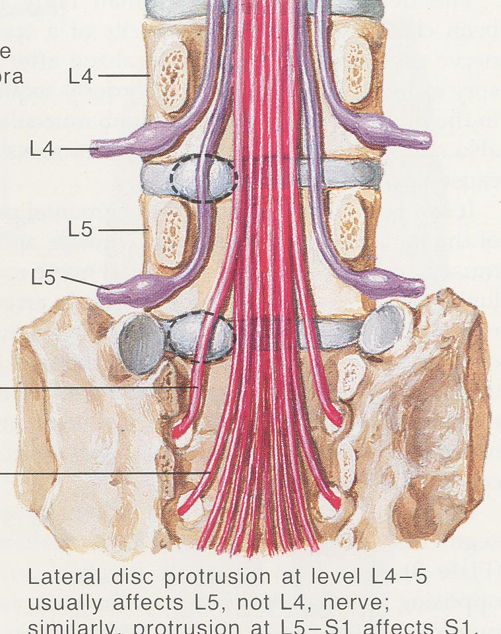

Slide 38
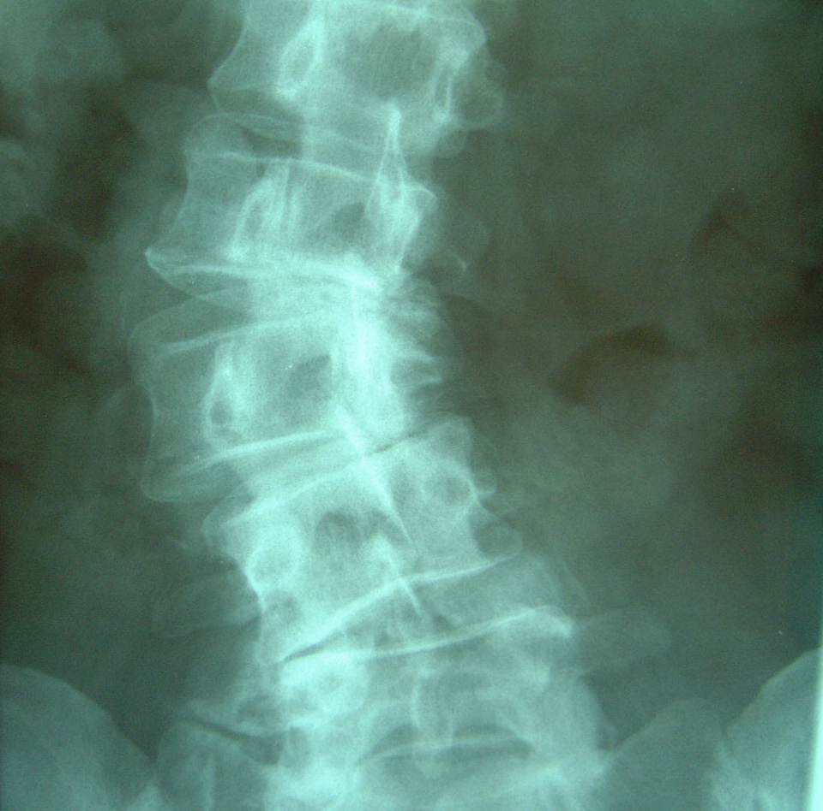
Etiology
Spondylogenic
Neurogenic
Vascular
Viscerogenic
Psychogenic

Slide 39
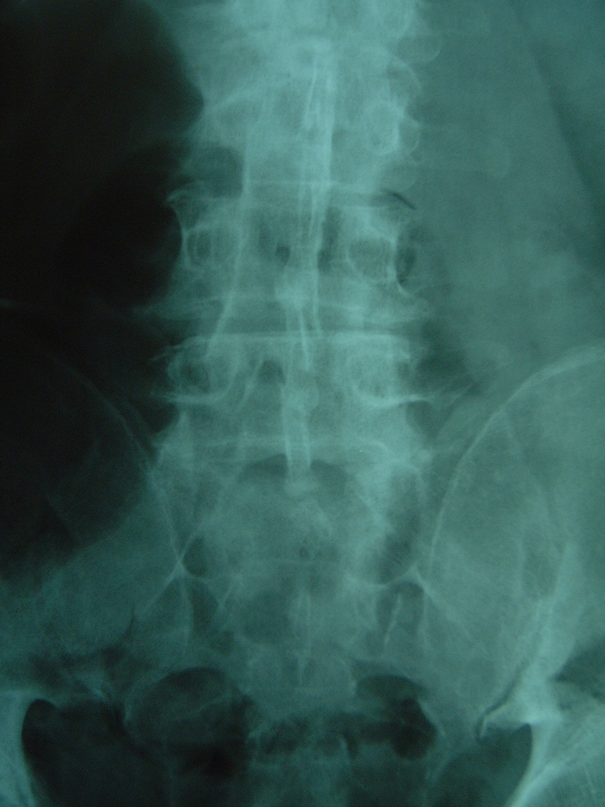
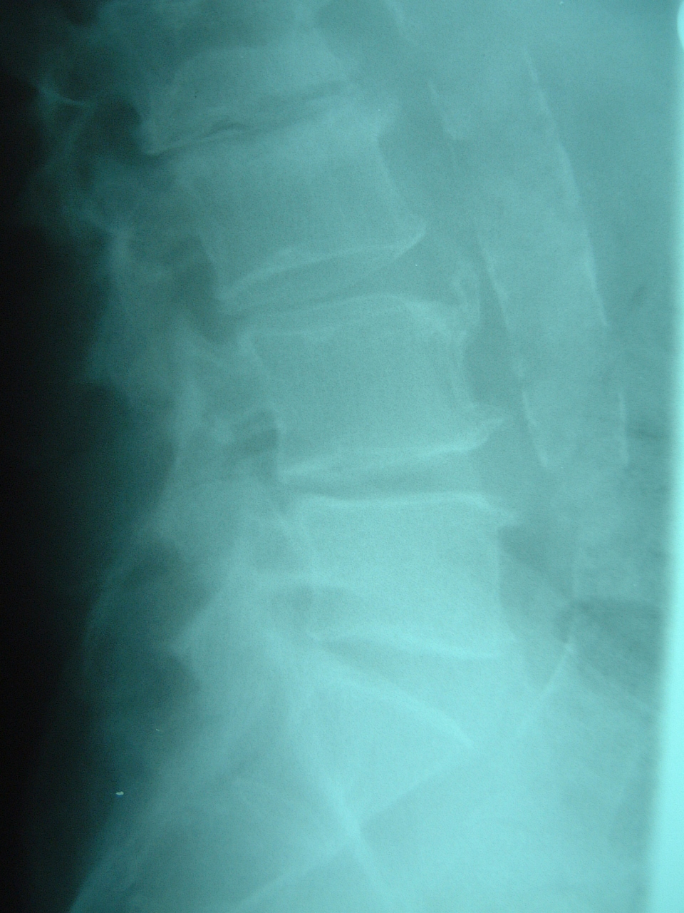
Vascular
Aneurysm
Peripheral vascular disease

Slide 40
Viscerogenic
Pancreas
Colon
Uterus
Etc.

Slide 41
Spondylogenic
Potentially serious
Tumor
Infection
Fracture
Cauda equina syndrome
Sciatica or back related leg pain
Non-specific back pain

Slide 42
Assessment
Look for “red flags”
Major trauma
Minor trauma in elderly
Hx of Ca.
Constitutional symptoms
IV drug use / immune suppressed
Pain worse at night or while supine
Saddle anesthesia / urinary retention
Progressive neurological deficit

Slide 43
Assessment
History precipitating event back v.s. leg pain night pain constitutional sympt’s
PMHx vascular trauma renal neoplasia

Slide 44
Physical exam
General observation
Regional back exam
Neurological screening
Nerve root tension testing

Slide 45
Red Flags
Severe neurologic loss
Infection ++ spasm
Trauma
Other areas
Abdomen
Pelvis
Pulses

Slide 46
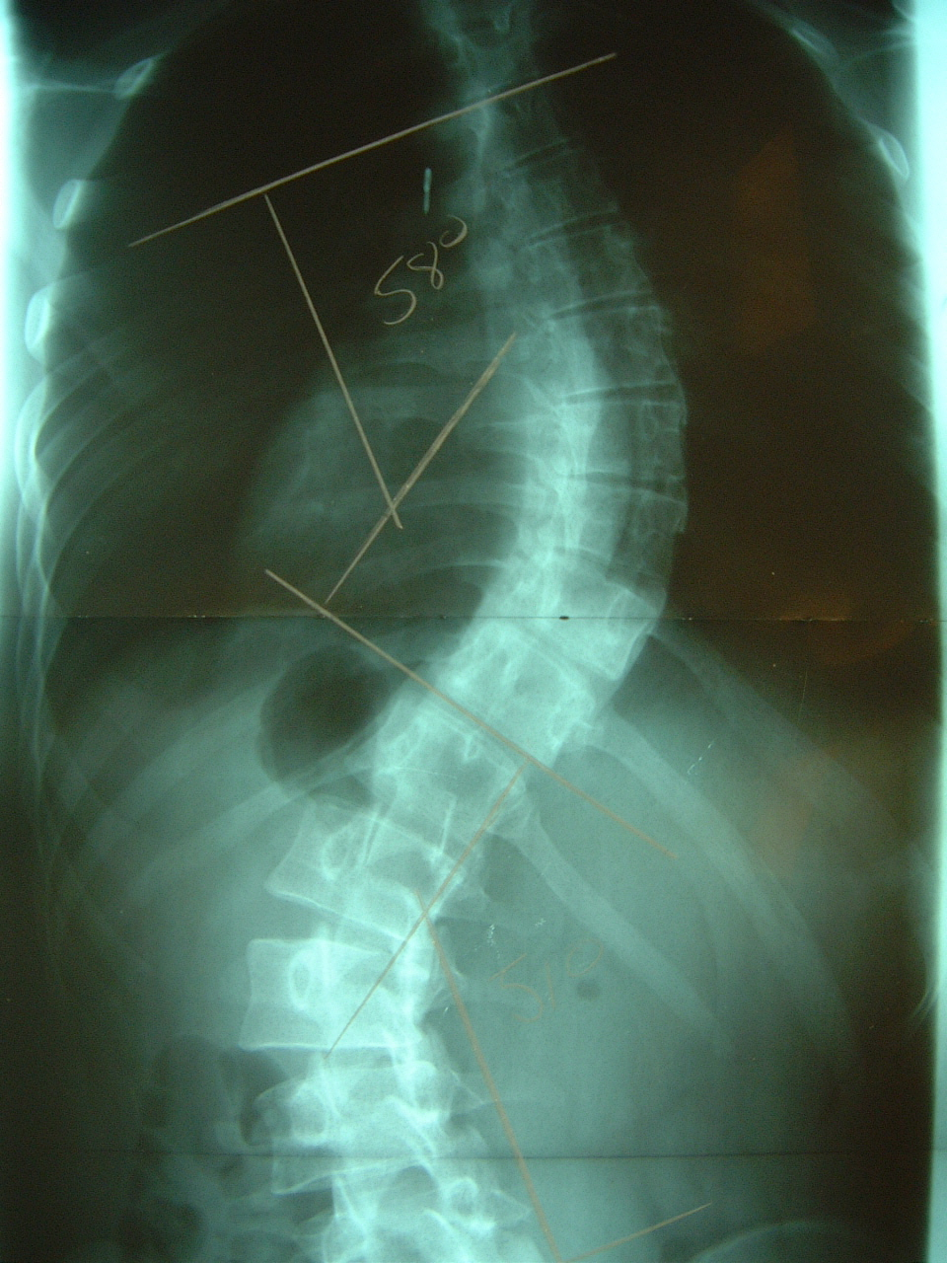
Observation/Back Exam
Limping, lack of coordination
Lordosis/scoliosis
Severe guarding in all planes
Range of motion (limited value)
Reversal of normal rhythm
Muscle spasm

Slide 47
BACK PAIN
70% strains/muscular
Discogenic
Degenerative/facets
Fracture
Spondylolisthesis
Tumor
Infection
Referred (retroperitoneal)

Slide 48
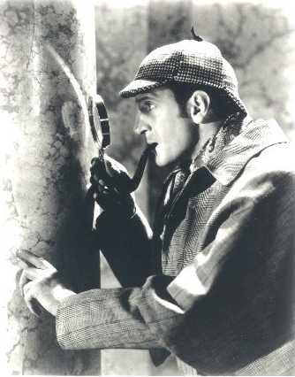
Investigation
In the absence of “Red Flags” none required in the first 4-6 weeks

Slide 49
Treatment
Acute LBP and Sciatica
Sub Acute LBP
Sub Acute Sciatica

Slide 50
Acute Low Back Pain
Advice
Stay active
Analgesics
acetaminophen
Anti inflammatories
If pain persists
All “equal”
Bed rest
Not recommended
Muscle relaxants
Not recommended
Manual therapy
For additional pain relief

Slide 51
Follow – Up
Within 2-4 weeks and reassess
At 6 weeks
X-Ray
Constitutional Symptoms
CBC/ESR
U/A
Bone scan
referral

Slide 52
Sub Acute Low Back Pain
Advice
Increase activity
Exercises
For reactivation and rehabilitation
Analgesics
Acetaminophen and codeine
Fixed period
Fixed times

Slide 53
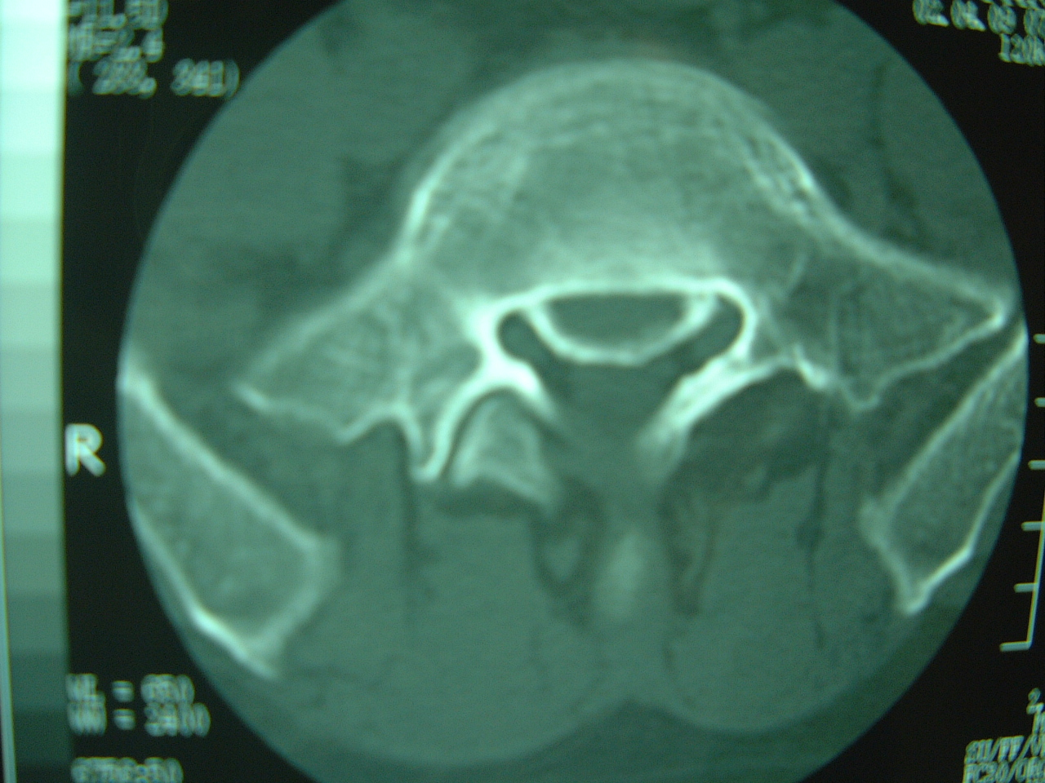
Sub Acute Sciatica
Longer than 6 weeks……refer

Slide 54
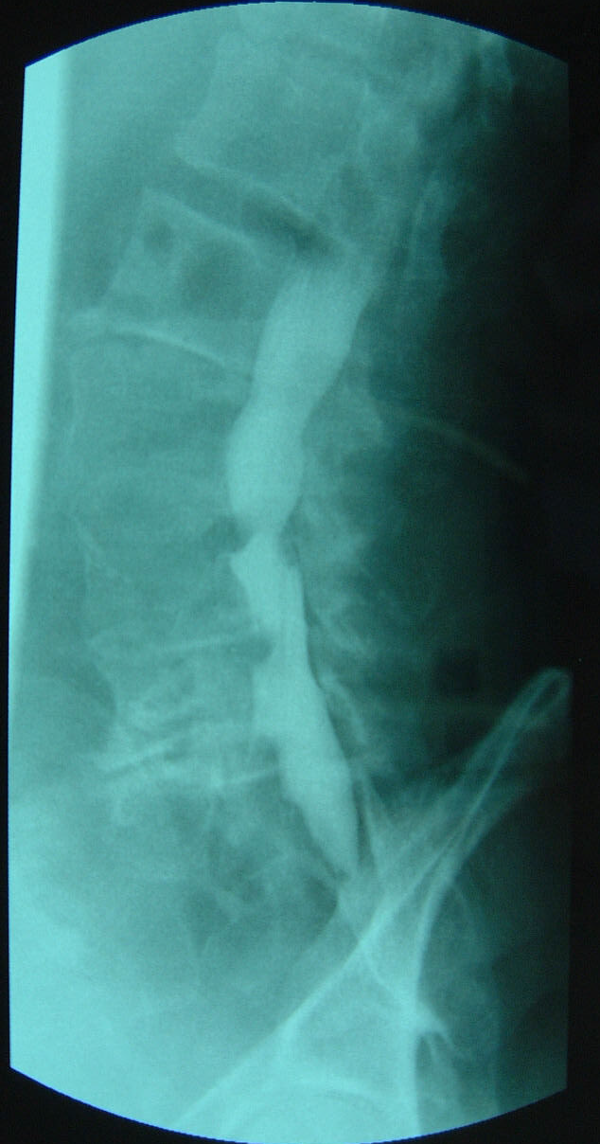
Further Investigation
EMG
For patients with subtle neurological findings
Does not change treatment
Not practical here
CT,MRI,Myelogram
Only when considering Surgery
Up to 30% false positive rate

Slide 55
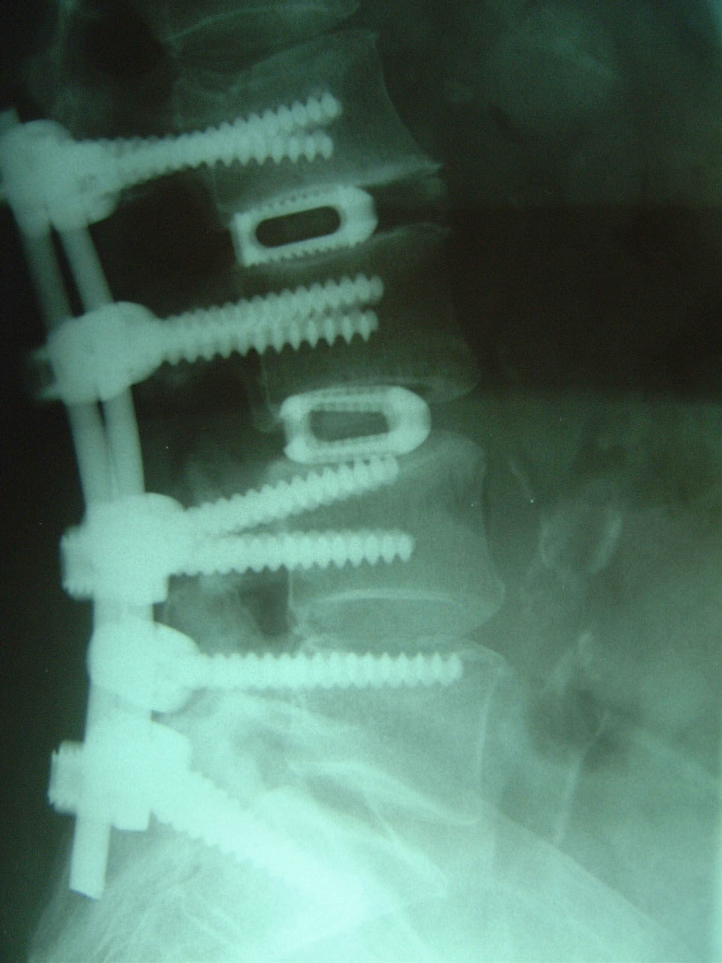
Treatment after 3 Months no “red flags”
Disc Protrusion
Surgery may help
Spondylolisthesis
Possible consideration for surgery
Chronic LBP
Surgery is little or no help

Slide 56
Chronic Back Pain Why Surgery Can’t Fix It

Slide 57
Chronic Back Pain Why Surgery Can’t Fix It
<50% success with fusion
Usually diffuse degenerative changes
Difficult to identify symptomatic level
root blocks
facet blocks
Discograms
MRI
external fixators

Slide 58
Chronic Back Pain Why Surgery Can’t Fix It
Pelvis protects and causes problems
Degenerative changes adjacent to fusion
Fusion rates 1 level 90% 2 level 70% >2 level less

Slide 59
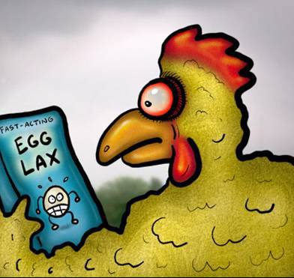
Chronic Low Back Pain
You can’t make chicken salad……

Slide 60
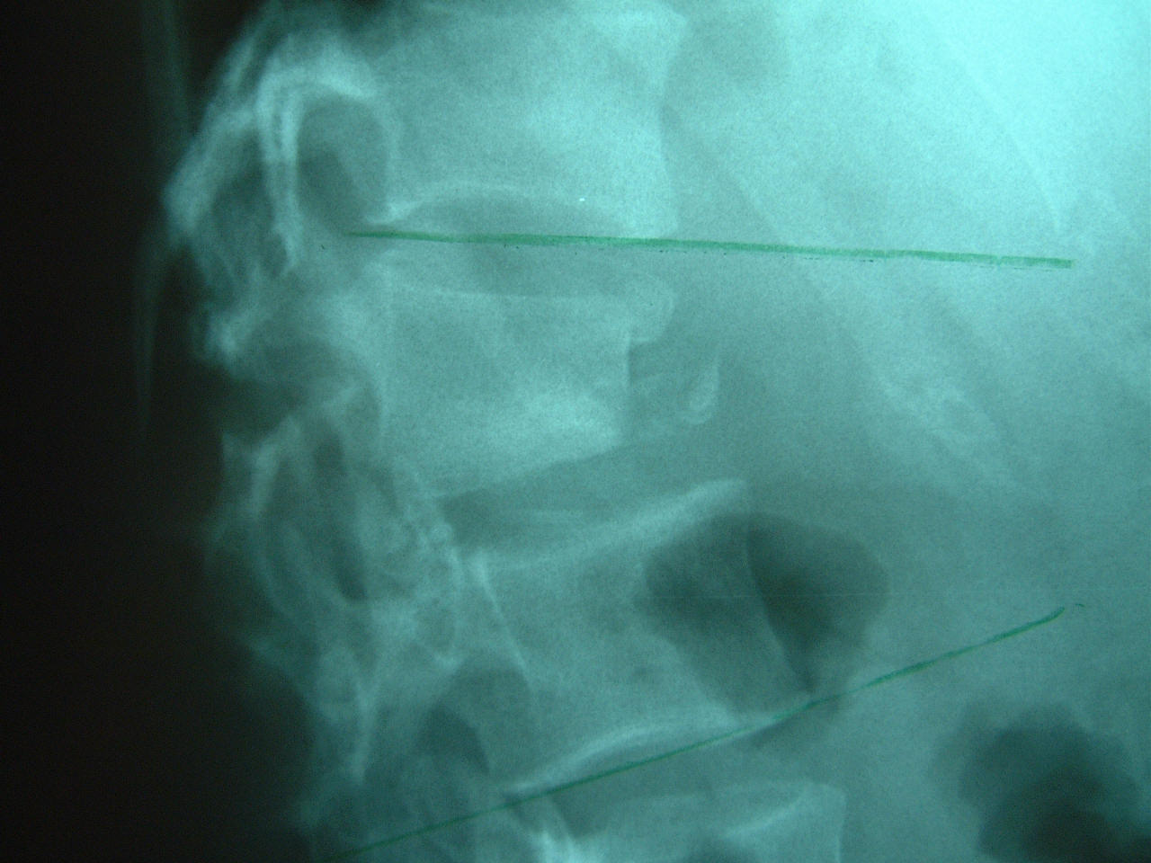
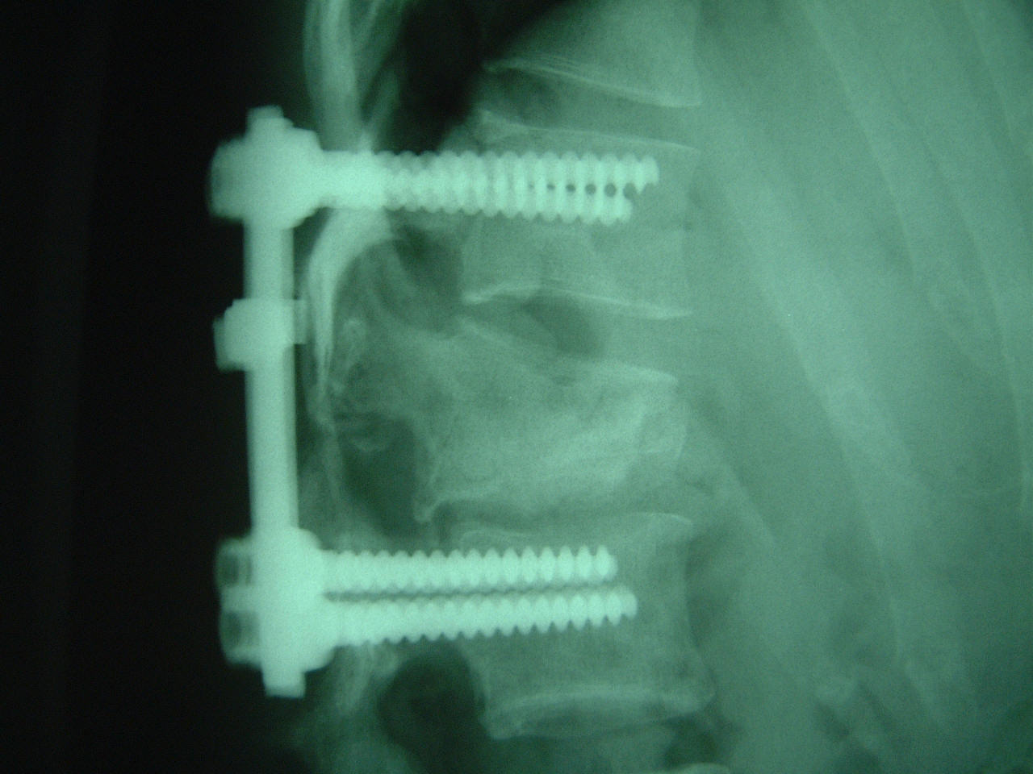
Back pain What I can Fix
Tumor
Infection
fracture

Slide 61
Kyphoplasty
Insufficiency #’s after 3 months
Osteoporosis
Primary or metastatic lesions
Neurologically intact
Tender to percussion
CT and Bone scan (MRI)

Slide 62
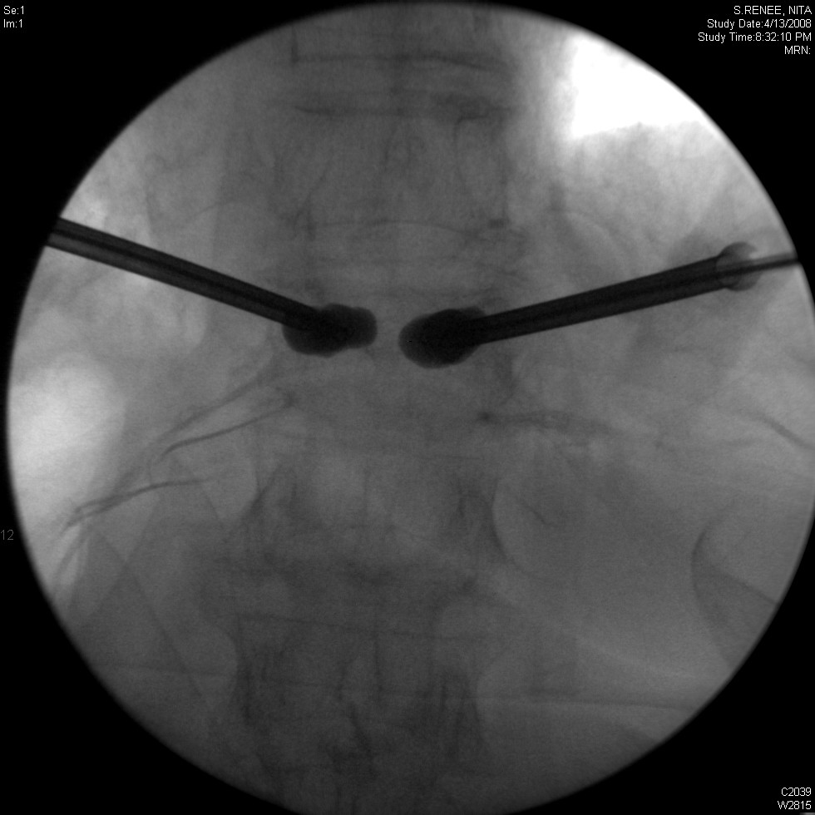
Kyphoplasty

Slide 63
Leg Pain
Disc protrusion
Spinal stenosis
Vascular (PVD/ aneurysm/ varicose veins
Hip / knee
Peripheral nerves

Slide 64
Leg Pain Disc Protrusion

Slide 65
Leg Pain Disc Protrusion
LBP & Leg Pain
Worse with sitting
Usually follows dermatomal distribution
80% better with physio.

Slide 66
Leg Pain Disc Protrusion
Bilateral leg pain, immediate referral
No better with Tx, early referral
Will eventually resolve
CT if no improvement

Slide 67
Leg Pain Spinal Stenosis
Usually elderly
Secondary to degenerative changes
Not usually good neurological findings
1/3 get better
1/3 stay the same
1/3 progress

Slide 68
Leg Pain Spinal Stenosis
Stenosis vs. Claudication
Worse with walking same
Relief sitting/bending standing
Relief takes 5-10 min. 1-2 min.
Good pulses poor pulses

Slide 69
Leg Pain Spinal Stenosis pathology
Compression of the thecal sac facets -osteophytes -thickened capsule loss of disc height –thickening of PLL -decreased interpedicular distance -wedging of facets

Slide 70
Leg Pain Spinal Stenosis

Slide 71
Leg Pain Spinal Stenosis

Slide 72
Leg Pain Spinal Stenosis Treatment
Diminish inflammation of facets
NSAID’S +/- physio.
NSAID’S & brace
Neuropathic pain medication
Epidural steroid
Live with the pain
Decompression +/- fusion
MRI, only for pre-op planning

Slide 73
Summary
I Can Fix:
disc protrusions
spinal stenosis
Fractures
tumors / infection
I Can’t Fix
chronic mechanical back pain

Slide 74
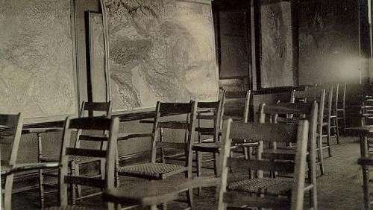
Any Questions?

Slide 75
Section D: Referrals
Notes:
Our hope is that you would feel comfortable in beginning the initial management. For those who you feel are not responding or that need a little more AND they meet the above criteria then refer to PT
10% of patients who are referred to a spinal surgeon need surgery
Criteria for referral for outpatient PT city hospital -? Check with Tracy

Slide 76
Diagnostic Imaging
In the absence of red flags, the guidelines from the American College of Radiology and Canadian Association of Radiologists do not recommend any imaging initially.
Leg dominant pain that is not responding to 6 weeks of appropriate conservative management or progressive neurological signs
Choosing Wisely Canada
https://choosingwiselycanada.org/pamphlet/imaging-tests-for-lower-back-pain/

Slide 77
Conservative Management Therapies
Active based therapy
Physiotherapy – public and private
Sports Medicine
Massage
Chiropractor
Acupuncture/ Dry Needling
Osteopath
Kinesiology
Community exercise programs, pools, etc.
TOP Guidelines, Almeida et al (2018); Dilitto et al (2021)
Notes:
When to refer to PT etc
If improving and doing well, may not require referral
If struggling to improve, and you feel they may require further assessment may consider further
The most important part is the actual active self management exercise, activity, etc. so they have to be willing to take ownership. Passive modalities may be part of their treatment but is not the main focus and is not the most important part of the treatment.
(e.g. YMCA, City of St. John’s, Summit)
Resources:
Active Lifestyle - Participaction Canada/ Movement Guidelines
Stress Management – Bridge the Gapp resources; referral to Mental Health Services

Slide 78
Current City Hospital LBP Pathway
Referral is triaged by a PT
Urgent acute (< 6 weeks) radiculopathy/ radicular pain
Non- urgent sent a letter about physiotherapy and LBP
Patients that call back are triaged on the phone for red flags and group criteria
Booked for individual or group education
Those that attend group have a follow up phone appointment to determine if they need an individual assessment
Notes:
Remind what a urgent radiculopathy/ radicular pain definition- they would be seen within 2 weeks.
Benefits of group based exercise programs Are group-based and individual physiotherapy exercise programs equally effective for musculoskeletal conditions? A systematic review O’Keeffe et al
and meta-analysis Mary O’Keeffe,1 Amy Hayes,1 Karen McCreesh,1 Helen Purtill,2 Kieran O’Sullivan1
Given education in back class, a lot of them are good with just the reassurance, education and advice.
Developing a booklet to distribute that we can share. It is completed just requires a little editing. Possibly could be something to give out in your clinics.

Slide 79
Resources (See QR Code Handout)
CORE Back Tool https://cep.health/media/uploaded/CEP_CORE_Back_2016.pdf
User guide CORE LBP Tool https://www.health.gov.on.ca/en/pro/programs/ecfa/docs/lb_tk_core_tool_guide_c.pdf
Saskatchewan Health Authority- Online training course https://www.saskhealthauthority.ca/our-organization/quality-care-patient-safety/quality-improvement/stewardship-and-clinical-appropriateness/clinical-pathways/spine-pathway/spine-pathway-provider-information/spine-pathway-online-0
LBP Rapid Access Clinics Tips for Your Low Back - RAPID ACCESS CLINIC LOW BACK PAIN (lowbackrac.ca)
Summary Guidelines PHC Management of LBP https://actt.albertadoctors.org/media/vcbnw2r3/lbp-summary.pdf
Alberta TOP Guidelines for LBP https://actt.albertadoctors.org/media/zpgdhot5/lbp-guideline.pdf
Bridge the Gapp (Power Over Pain Portal) https://nl.bridgethegapp.ca/adult/

Slide 80
Thank-You

Slide 81
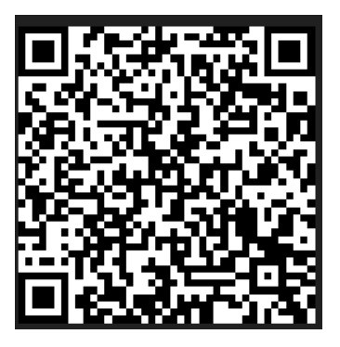
Evaluation
Please take a moment to provide some feedback on this event

Slide 82
References
Almeida, M., Saragiotto, B., Richards, B., & Maher, C. G. (2018). Primary care management of non‐specific low back pain: key messages from recent clinical guidelines. Medical Journal of Australia, 208(6), 272-275.
Brinjikji, W., Luetmer, P. H., Comstock, B., Bresnahan, B. W., Chen, L. E., Deyo, R. A., ... & Jarvik, J. G. (2015). Systematic literature review of imaging features of spinal degeneration in asymptomatic populations. American journal of neuroradiology, 36(4), 811-816.
Chou, R., Deyo, R. A., & Jarvik, J. G. (2012). Appropriate use of lumbar imaging for evaluation of low back pain. Radiologic Clinics, 50(4), 569-585.
Dilitto A, George S, et al. Interventions for the Management of Acute and Chronic Low Back Pain: Revision 2021 Clinical Practice Guidelines Linked to the International Classification of Functioning, Disability and Health From the Academy of Orthopaedic Physical Therapy of the American Physical Therapy Association J Orthop Sports Phys Ther. 2021;51(11)
Dziedzic K, French S, Davis A, et al. Implementation for musculoskeletal models of care in primary care settings: Theory, practice, evaluation and outcomes for musculoskeletal health in high-income economies. Best Practice & Research Clinical Rheumatology. 2016; 375-397.
Finucane, L. M., Downie, A., Mercer, C., Greenhalgh, S. M., Boissonnault, W. G., Pool-Goudzwaard, A. L., ... & Selfe, J. (2020). International framework for red flags for potential serious spinal pathologies. journal of orthopaedic & sports physical therapy, 50(7), 350-372.
Foster N, Mullis R, Hill J, et al. Effect of stratified care for low back pain in family practice (IMPaCT Back): A prospective population-based sequential comparison. An Fam Med. 2014; 12(2):102-111.
Global Burden of Disease. Global, regional, and national incidence, prevalence, and years lived with disability for 328 diseases and injuries for195 countries, 1990–2016: a systematic analysis for the Global Burden of Disease Study 2016. Lancet. 2017; 390-1112-59.
Hall, H., McIntosh, G., & Boyle, C. (2009). Effectiveness of a low back pain classification system. The Spine Journal, 9(8), 648-657.

Slide 83
References
Henschke, N., Maher, C. G., Refshauge, K. M., Herbert, R. D., Cumming, R. G., Bleasel, J., ... & McAuley, J. H. (2009). Prevalence of and screening for serious spinal pathology in patients presenting to primary care settings with acute low back pain. Arthritis & Rheumatism: Official Journal of the American College of Rheumatology, 60(10), 3072-3080.
Hurley J, Mccreesh K, O’Sullivan KEffect of education on non-specific neck and low back pain: A meta-analysis of randomized controlled trials: letter to the editor. Article in Manual therapy · March 2016
Moseley L & Butler D. The Journal of Pain, Vol 16, No 9 (September), 2015: pp 807-813
Nunn N, Hayden J, Magee K. Current management practices for patients presenting with low back pain to a large emergency department in Canada. BMC Musculoskeletal Disorders. 2017;18:92.
O'Keeffe, M., Hayes, A., McCreesh, K., Purtill, H., & O'Sullivan, K. (2017). Are group-based and individual physiotherapy exercise programmes equally effective for musculoskeletal conditions? A systematic review and meta-analysis. British journal of sports medicine, 51(2), 126-132.
Oliveira, C. B., Maher, C. G., Pinto, R. Z., Traeger, A. C., Lin, C. W. C., Chenot, J. F., ... & Koes, B. W. (2018). Clinical practice guidelines for the management of non-specific low back pain in primary care: an updated overview. European Spine Journal, 27, 2791-2803.
Rampersaud Y, Alleyne J, Hamilton H. Low Back Pain: It’s Time for a Different Approach. Journal of Current Clinical Care. 2013; 6-11.
Richmond H, Hall A, Copsey B, Hansen Z, et al. The effects of cognitive behavioural treatment for non-specific low back pain: a systematic review and meta-analysis. PLOS One, 2015.

Slide 84
References
Schenk, R., Lawrence, H., Lorenzetti, J., Marshall, W., Whelan, G., & Zeiss, R. (2016). The relationship between Quebec Task Force Classification and outcome in patients with low back pain treated through mechanical diagnosis and therapy. Journal of Manual & Manipulative Therapy, 24(1), 21-25.
Toward Optimized Practice. Guidelines for the Evidence Informed Primary Care Management of Low Back Pain 2nd Edition. Accessed at www.topalbertadoctors.org
Traeger, A. C., Huebscher, M., Henschke, N., Moseley, G. L., Lee, H., & McAuley, J. H. (2015). Effect of primary care–based education on reassurance in patients with acute low back pain: systematic review and meta-analysis. JAMA internal medicine, 175(5), 733-743.

